Slide 1
Model Selection,
Introduction to Machine learning.
Linear Regression –
Bias Variance Decomposition
Basis Function models,

Slide 2
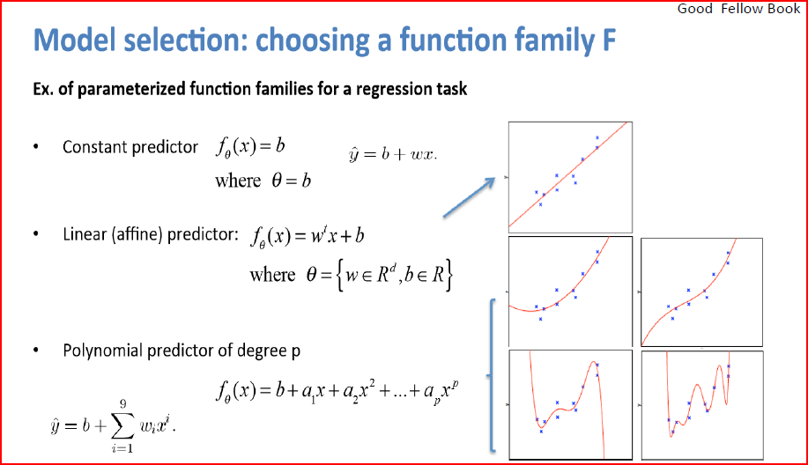

Slide 3
Model Selection
In our example of polynomial curve fitting using least squares, we saw that there was an optimal order of polynomial that gave the best generalization.
The order of the polynomial controls the number of free parameters in the model and thereby governs the model complexity.
With regularized least squares, the regularization coefficient λ also controls the effective complexity of the model,
whereas for more complex models, such as mixture distributions or neural networks there may be multiple parameters governing complexity.
We have already seen that, in the maximum likelihood approach, the performance
on the training set is not a good indicator of predictive performance on unseen
data due to the problem of over-fitting.

Slide 4
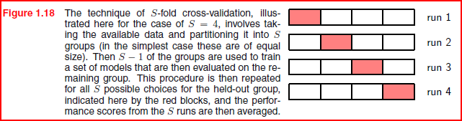

Slide 5
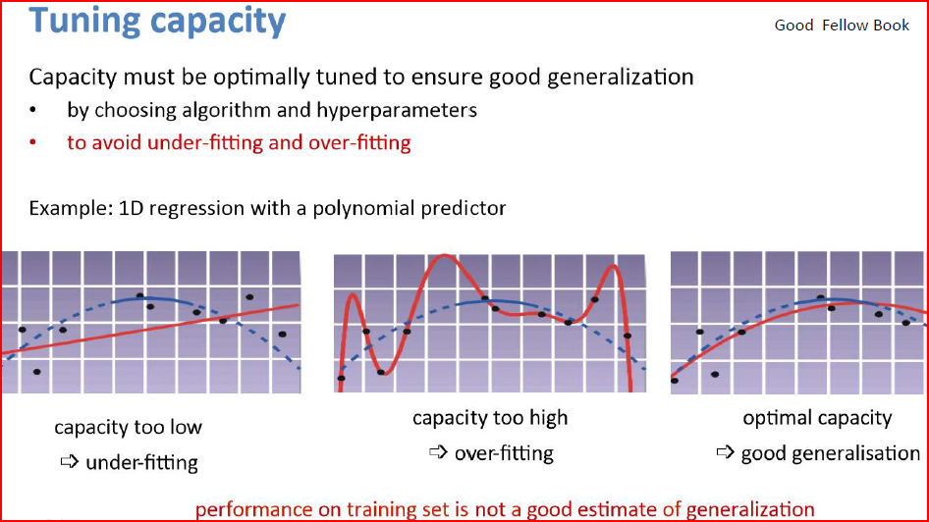

Slide 6
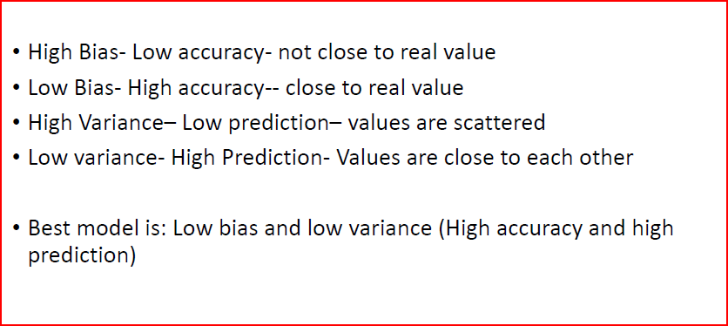
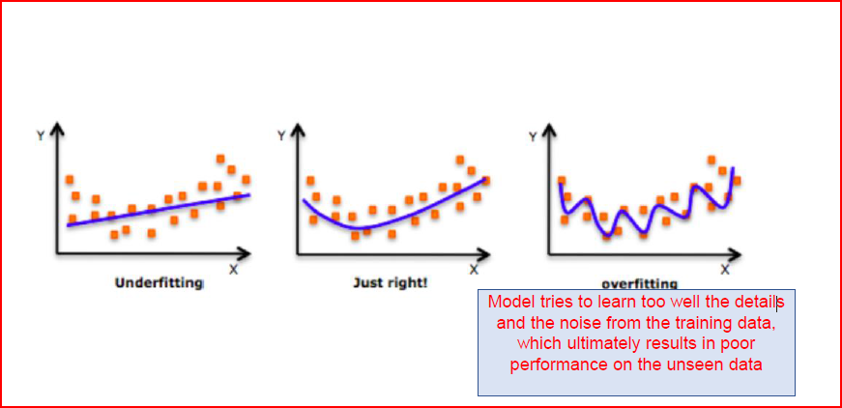

Slide 7
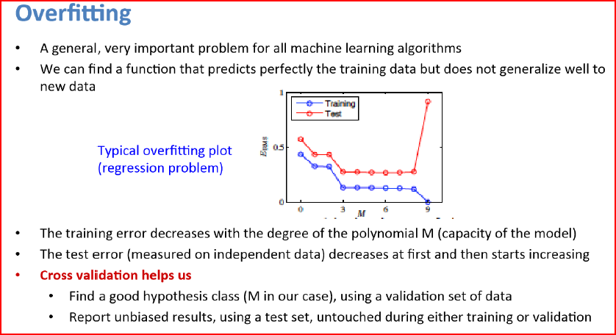

Slide 8
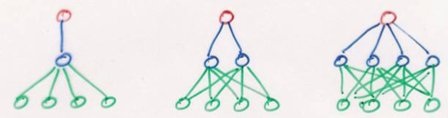
Restricting Models
Models range in their flexibility to fit arbitrary data
simple model
constrained
small capacity may prevent it from representing all structure in data
high bias
low variance
low bias
high variance
complex model
unconstrained
large capacity may allow it to fit quirks in data and fail to
capture regularities
Notes:
constrained : unconstrained :: parametric : nonparametric

Slide 9
Bias-Variance Trade Off
MSE
variance
bias²
Notes:
MSE is high on left because bias^2 is high
MSE is high on right because variance is high
[*] optimal complexity

Slide 10
Bias-Variance Trade Off Is Revealed Via Test Set Not Training Set
MSE_{test}
MSE_{train}
Notes:
early stopping and deep nets bengio ICLR
batch norm
understanding deep learning rethinking generalizationf
kushner H Weak confergence methods and singularly perturbed stochastic control and filtering problems
Borkar – stochastic approximation with two time scales
l.dickens@ucl.ac.uk

Slide 11
Current Perspective In Machine Learning
We can learn complex domains using
low bias model (deep net)
tons of training data
But will we have enough data?
E.g., speech recognition
more
data
more
data
Notes:
[*] What does tons of training data do for us in terms of bias-variance trade off?
Doesn’t affect bias
[*] Reduces variance
[*] allows more complex model to be used [shift of optimal complexity to the right]

Slide 12
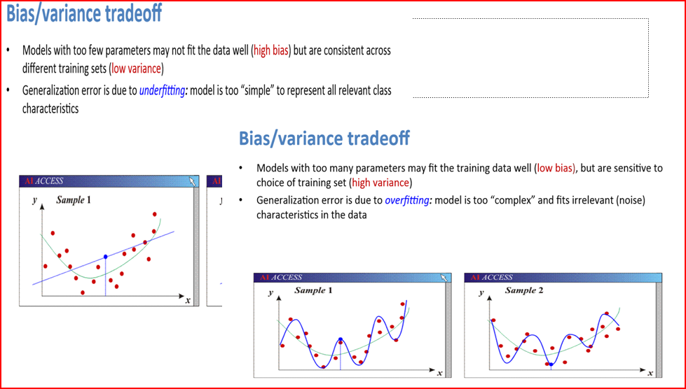

Slide 13
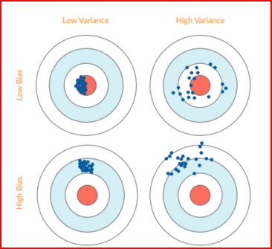
Bias –Variance trade off
Bias: (y-y predicted)
It is the Difference between actual output and predicted output.
Higher the difference high the bias value.
Variance: How much scattered the predicted value from each other(more scattered)is measured by variance. High the variance more the scatterd data points are.

Slide 14
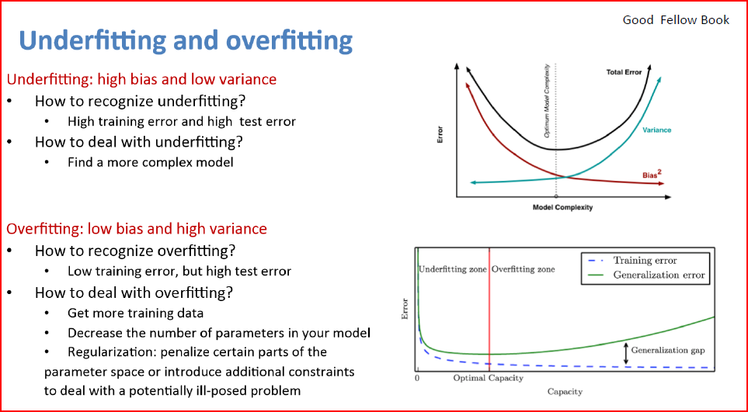

Slide 15
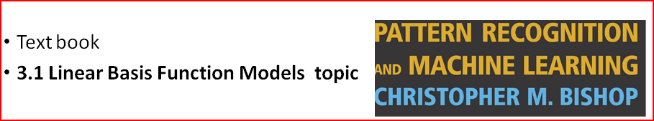
Bias –Variance Decomposition
The use of maximum likelihood or equivalently least squares can lead to severe over fitting.
if complex model are trained using data set of limited size.
Limiting the number of basis functions in order to avoid overfitting has the side effect of limiting the flexibility of the model to capture the interesting and important trends in data.
Bayesian view of design model can avoid the problem of over-fitting.

Slide 16
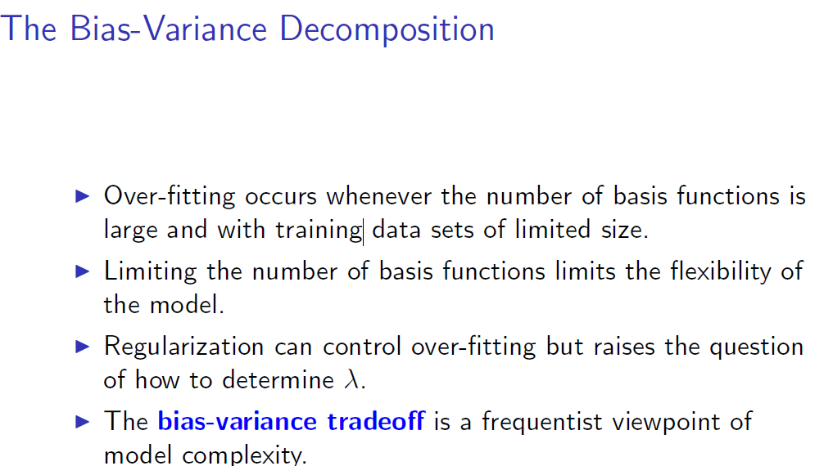

Slide 17
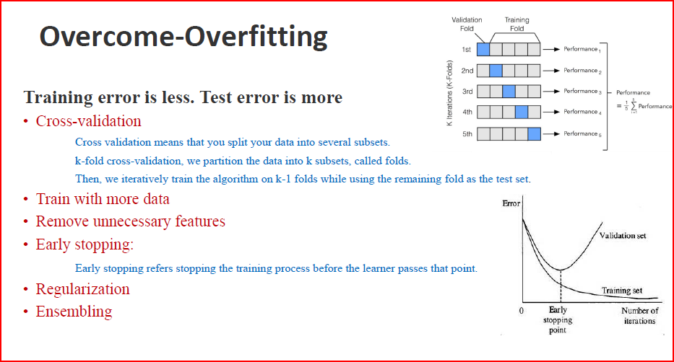

Slide 18



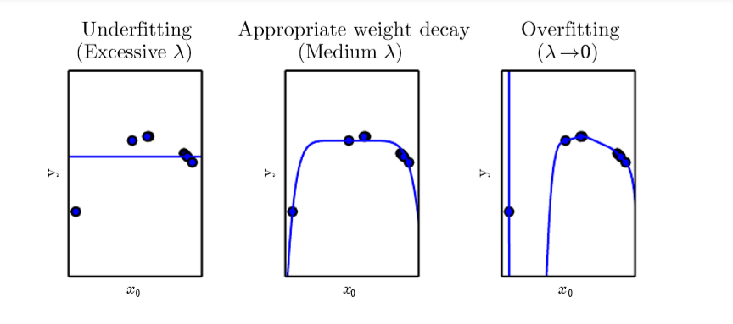
Regularization
Modify the training criterion for linear regression to include weight decay
In the polynomial regression example

Slide 19
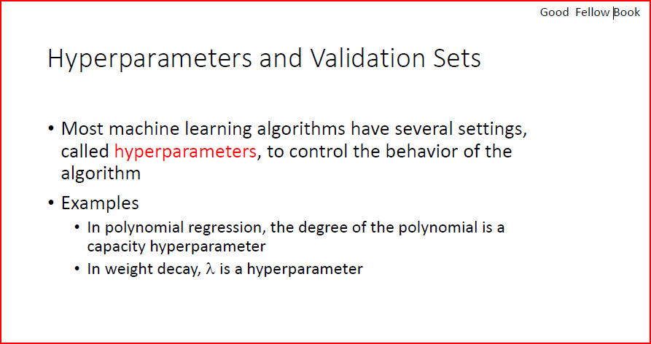

Slide 20
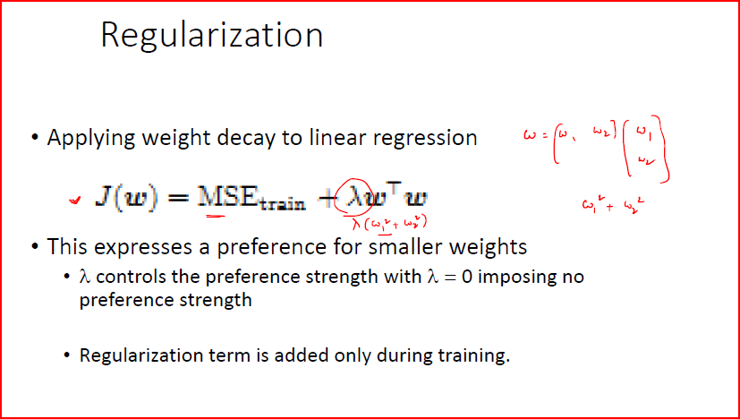

Slide 21
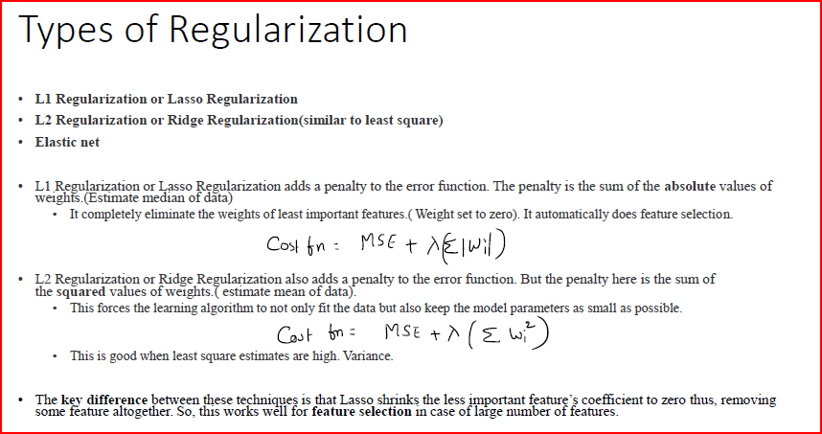

Slide 22
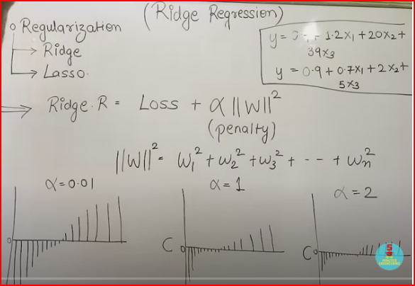
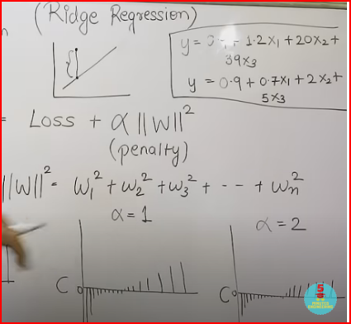
1Contribution by feature X3 is the most, because of high coefficient value.
2. It increase the high calculation complexity and become computational expensive
3. To reduce the magnitude of the coefficient(shirnk)
4.Loss=Predicted value of output-actual value of output

Slide 23
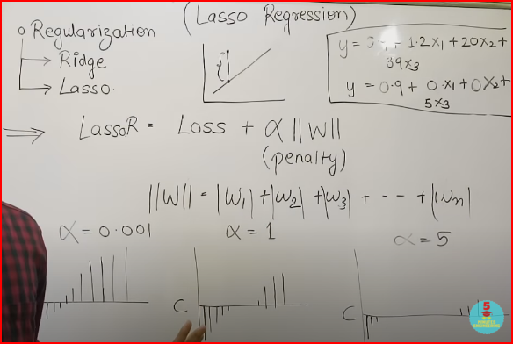
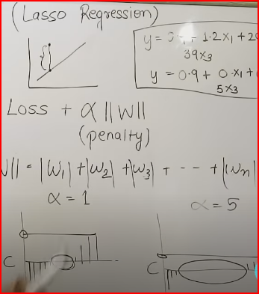
As increase in value of alpha , decrease in the value of regression coefficient

Slide 24
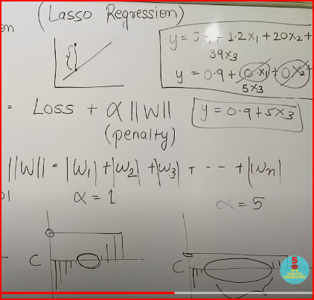
Increase in alpha proportion to decrease in coefficient value to zero
2. Indicates that particular coefficient are not adding value to the linear equation
3. Minimize the complexity of the system
4. Feature selection (cancelation of features ,), reduce the overfitting problem
5.

Slide 25
Over-fitting:
Steep slope(small change in input gives more variation in output (y/x)
Complex and complicated model as the coefficient values are high (steep slope)
Ridge and lasso regularization are used to decrease the stipness of the slope.
High variance (more susceptible to variation in input )
Low bias
Model with too many parameters fit the training data well (low bias) but very sensitive to noise (High variance) steep slope may be one of the resion.
Under-fitting:

Slide 26
Data bias in machine learning is a type of error in which certain elements of a dataset are more heavily weighted and/or represented than others.
A biased dataset does not accurately represent a model's use case, resulting in skewed outcomes, low accuracy levels, and analytical

Slide 27
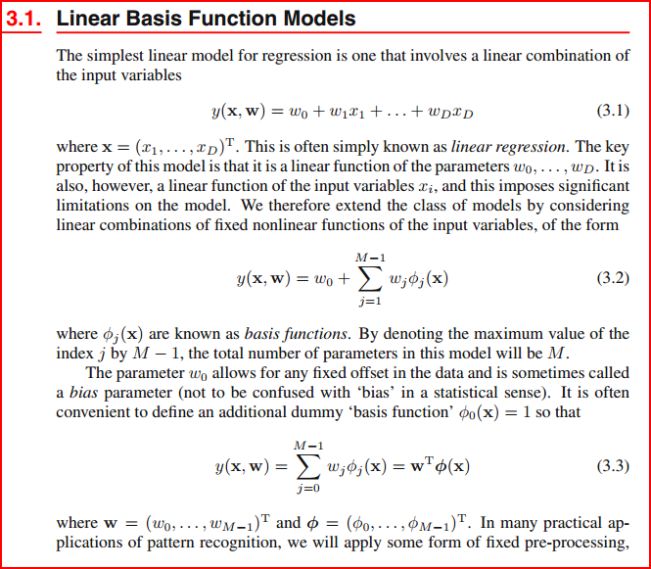

Slide 28
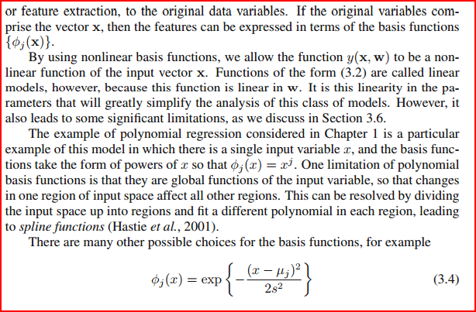

Slide 29
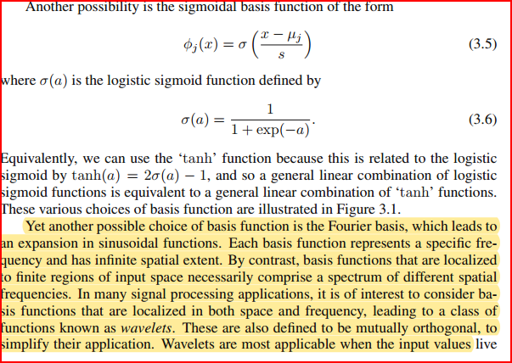

Slide 30
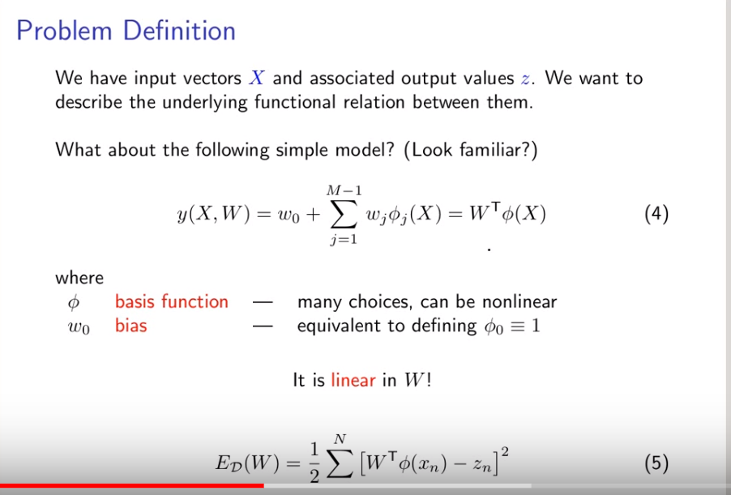

Slide 31
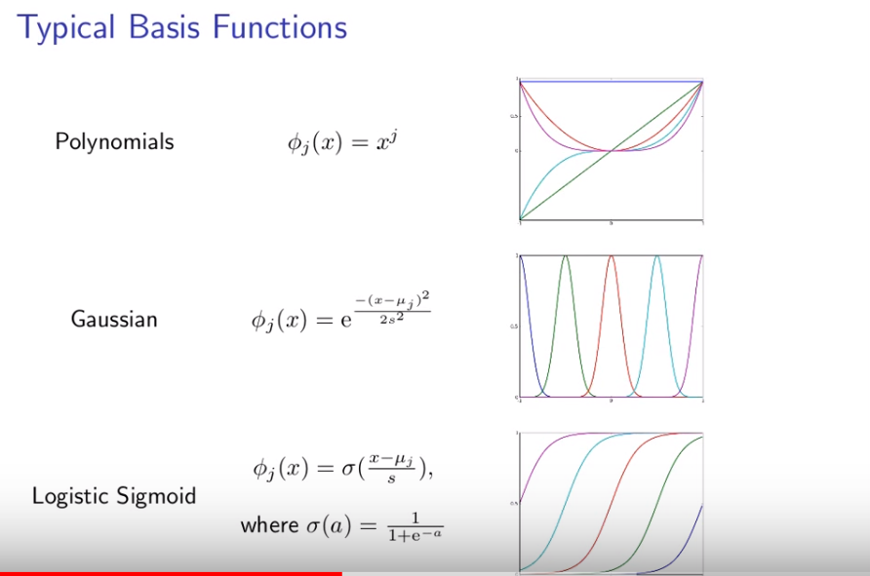

Slide 32
